Slide 1
UAV Mission Computer Software (Simplified)
A: message is Valid
Radio Driver
Flight Planner
UART Driver
G: message is Valid (authenticated)
G: well-formed mission

Slide 2
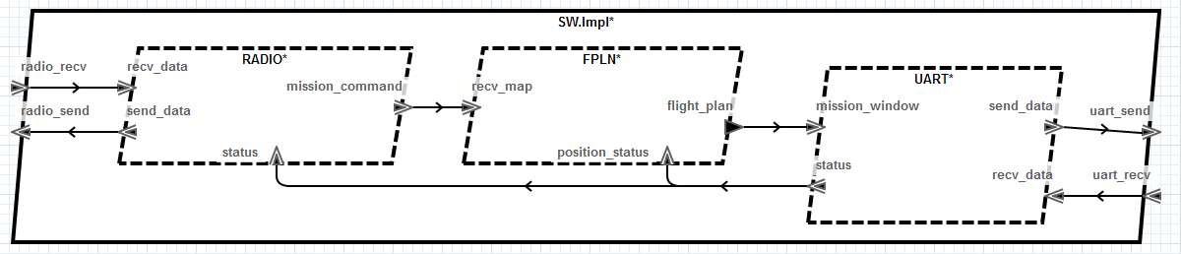
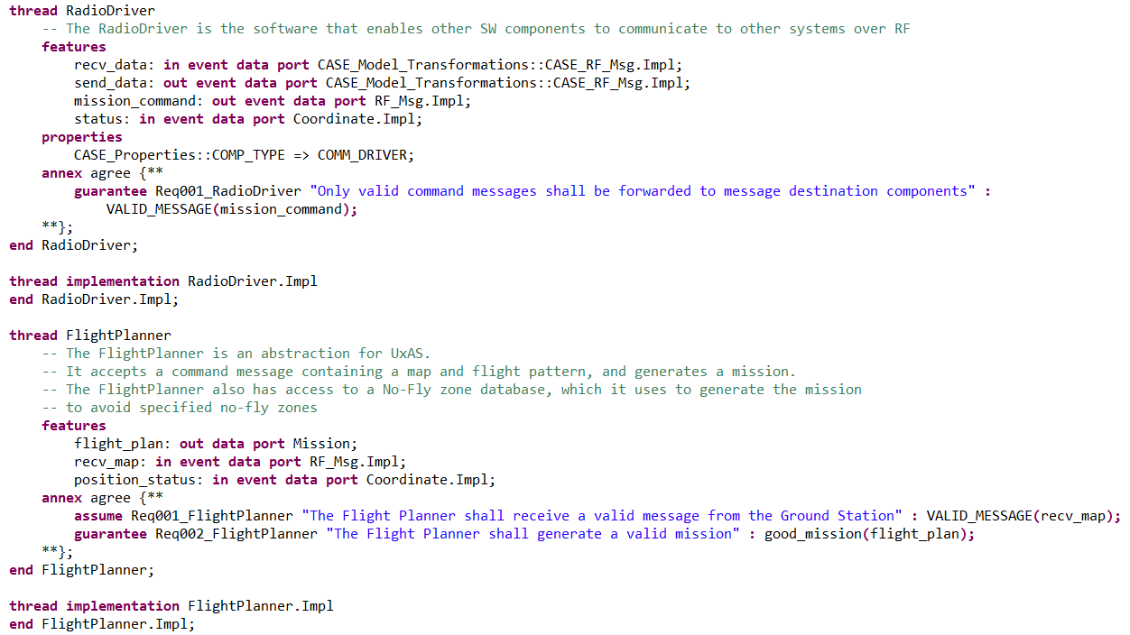
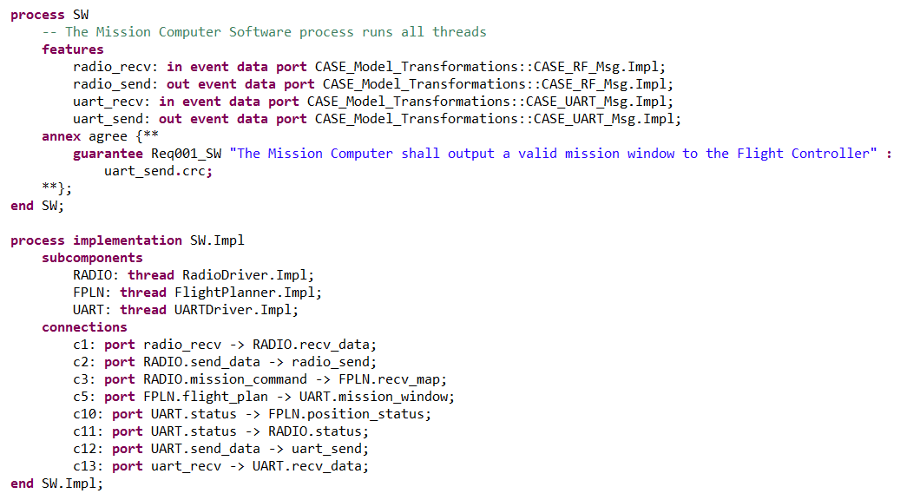

Slide 3
UAV Mission Computer Software (Simplified) with Attestation Manager model transformation
A: message is Valid and Trusted
A: Valid message
Radio Driver
Attestation Manager
Flight Planner
UART Driver
G: Valid message
G: message is Trusted (passes remote attestation)
G: well-formed mission

Slide 4
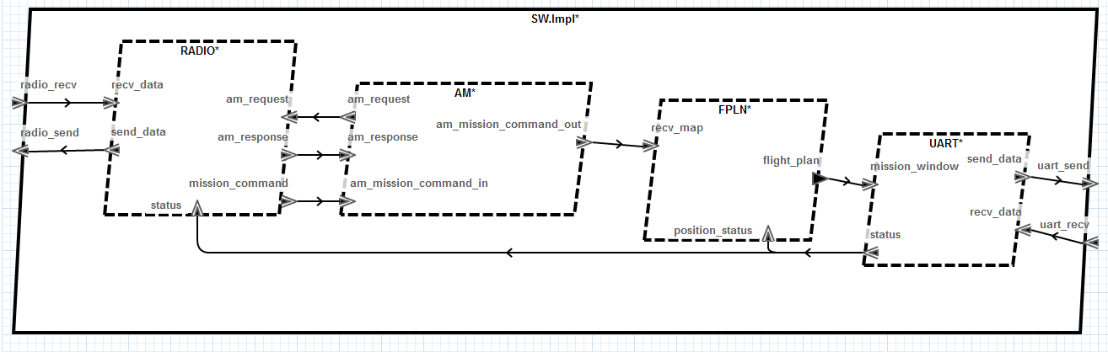
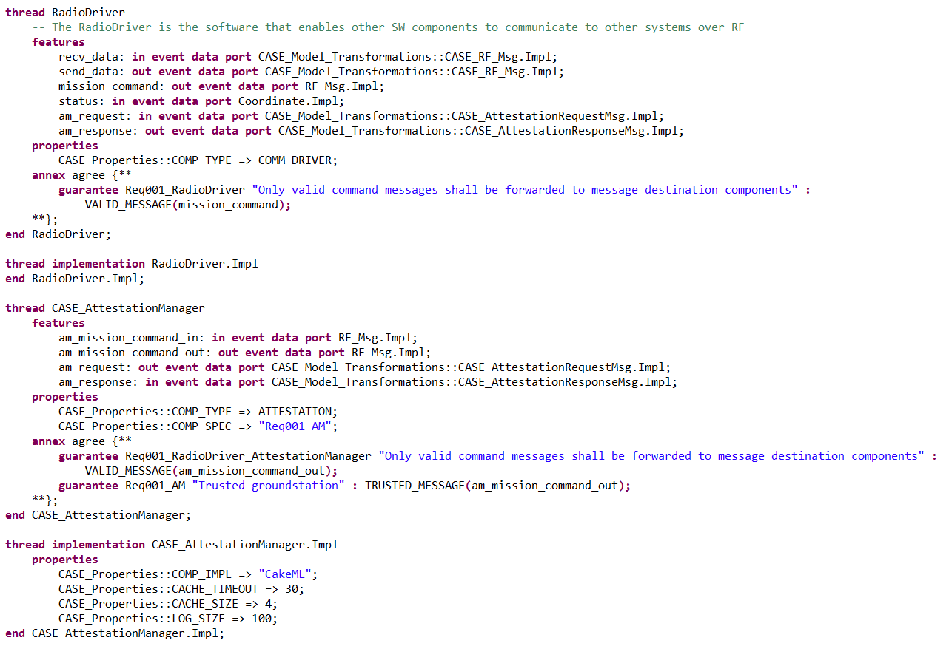
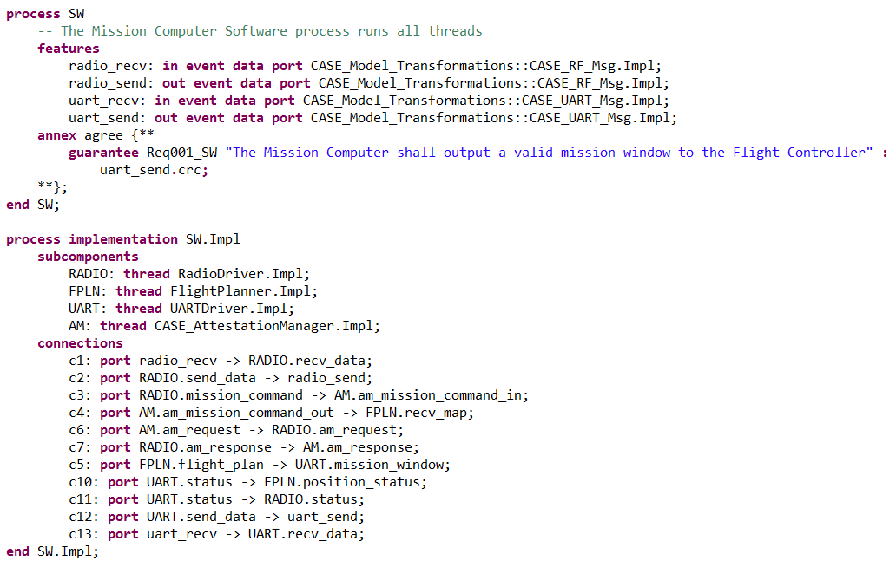

Slide 5
Problem with RadioDriver
Transformation modifies RadioDriver component by adding two new features:
am_request : in data port
am_response: out data port
This modification will be reflected in other implementations that contain RadioDriver
We don’t want this!
Options
Use transformed RadioDriver → BAD
Create a copy of RadioDriver and use in transformed model → LESS BAD
Extend RadioDriver and use in transformed model → OKAY, I GUESS

Slide 6
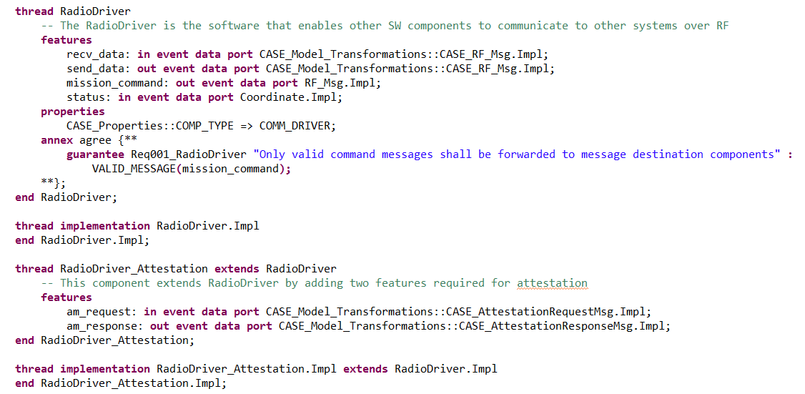
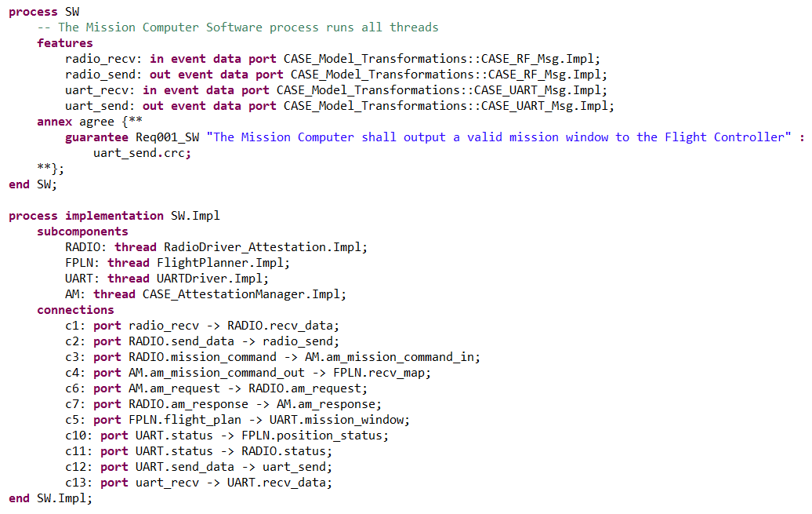
Extending RadioDriver Component
Source Example: https://github.com/loonwerks/CASE/blob/master/TA2/Simple_Example_V3_Exploratory/SW_EXTEND.aadl

Slide 7
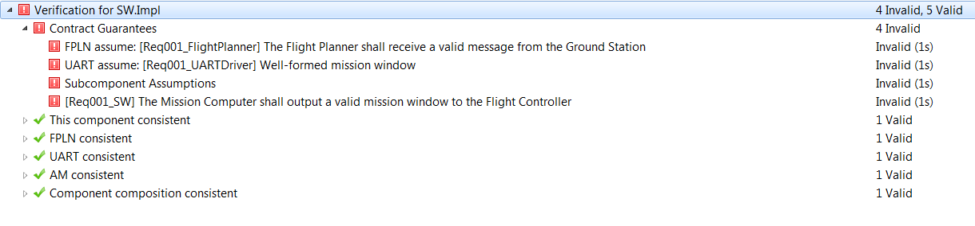
Problem with Extending RadioDriver
AGREE statements specified in RadioDriver are not extended
→ AGREE will fail

Slide 8
AGREE Basic Semantics for extend
Contracts only in components declaring the feature or local variable
Contracts automatically move down the type hierarchy as expected
Implementations may re-define component local variables etc.
Enforces the principle of sub-contracting
thread RadioDriverA extends SW::RadioDriver
features
am_request: in event data port CASE_Model_Transformations::CASE_AttestationRequestMsg.Impl;
am_response: out event data port CASE_Model_Transformations::CASE_AttestationResponseMsg.Impl;
annex agree{**
assume Req01_Valid “Req01_Valid” : SW::VALID(am_request);
guarantee Req02_Valid “Req02_Valid”: SW::VALID(am_response);
**}
end RadioDriver;

Slide 9
AGREE Advanced Semantics for extend
Non-declaring components may weaken the assumption
Non-declaring components may strengthen the guarantee
Applies to all features and local variables and not just a subset
Replaces prior obligations entirely (must be proved)
Add super keyword for convenience
thread RadioDriverB extends RadioDriverA
annex agree{**
guarantee super.Req02_Valid and super.Req001_RadioDriver;
guarantee Req03_status “Good status”: good_coordinate(status);
**}
end RadioDriver;
Notes:
Drops assumptions (weaker) and adds a new requirement on the status).

